Slide 1
Capstone Design Presentation

Slide 2
Meet the Team
1
AN JISU
LEE HYUNJAE
JEON JINWOO
Jane Doe
Jane Doe
Jane Doe
BACKEND DEVELOPER
backend developer
FRONTEND DEVELOPER
Server management, Server-side development
Database, Server-side development
Highlight algorithm, Dashboard UI
ajs7270@gmail.com
leehj8687@email.com
zinuzian@gmail.com
Notes:
© Copyright Showeet.com – Creative & Free PowerPoint Templates

Slide 3
Contents
12th week’s progress
Schedule
Q&A

Slide 4
12th week’s progress
Final Highlight algorithm : Hyunjae
Developing model & testing :Jisu
UI reconstruction & Mailing : Jinwoo

Slide 5
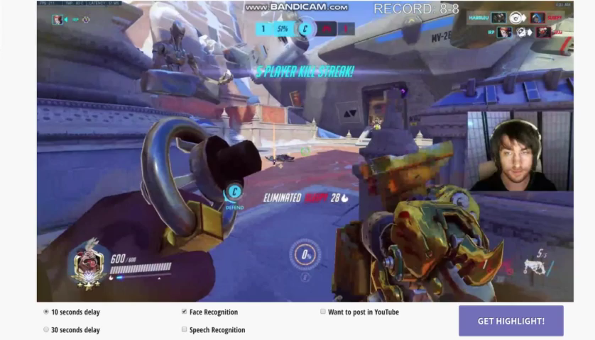

Slide 6
12th week’s progress
1. Final Highlight algorithm : Hyunjae

Slide 7
[1] Final Highlight algorithm
upload
Chatlog download
Chat Analyze
Face detection
Get time sections

Slide 8
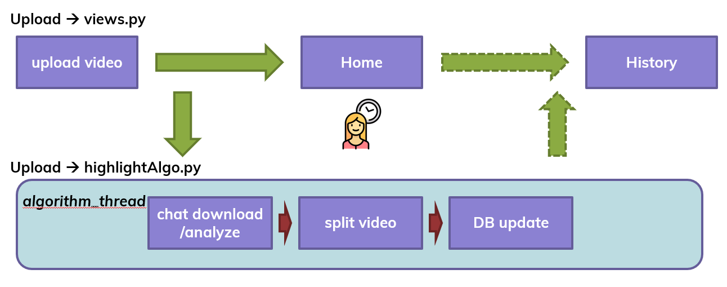
[1] Final Highlight algorithm
upload
Queueing for threads

Slide 9
[1] Final Highlight algorithm
Chatlog download

Slide 10
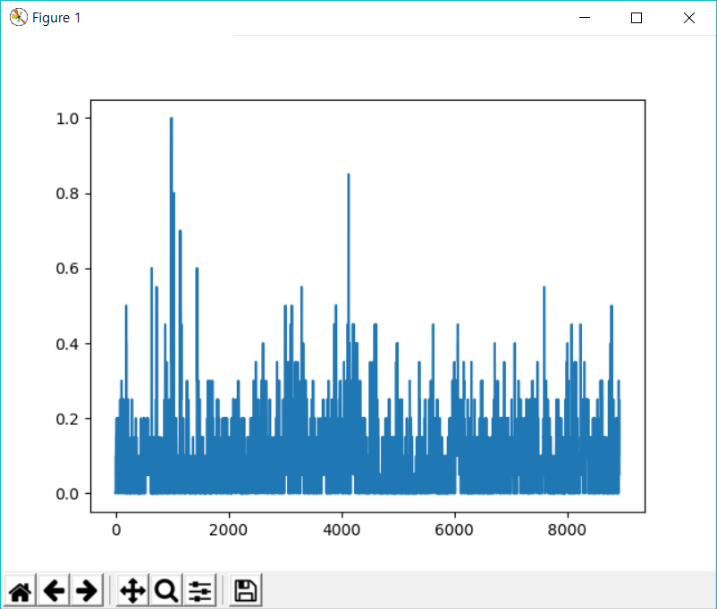
[1] Final Highlight algorithm
Chat
Analyze
Score each time(sec)
with labeled words

Slide 11
[1] Final Highlight algorithm
Chat
Analyze
[Example]
00:05:05 : 0.5,
00:07:05 : 1.0,
00:15:06 : 0.7,
00:25:08 : 0.8,
00:35:13 : 0.3,
…
Pick ‘X’ specific moments in descending order of ‘score’
And arrange them in descending order of ‘time’

Slide 12
[1] Final Highlight algorithm
Face
detection
Check if the specific time has a detected face and
max(emotion probability)
00:05:05 : 0.5 (Sad)
00:07:05 : 0.8 (Happy)
00:15:06 : 0.5 (Fear)
00:25:08 : 0.8 (Surprise)
00:35:13 : 0.3 (Happy)
…
[Example]
00:05:05 : 0.5,
00:07:05 : 1.0,
00:15:06 : 0.7,
00:25:08 : 0.8,
00:35:13 : 0.3,
…
emotions = ["Fear", "Happy", "Sad", "Surprise", "Neutral"]

Slide 13
[1] Final Highlight algorithm
Face
detection
Check if the specific time has a detected face and
max(emotion probability)
00:05:05 : 0.5 (Sad)
00:07:05 : 0.8 (Happy)
00:15:06 : 0.5 (Fear)
00:25:08 : 0.8 (Surprise)
00:35:13 : 0.3 (Happy)
…
We will consider next 5 seconds to get more correlations
00:05:05 : 0.5 + 0.6 + 0.3 + 1.0 + 0.8 / 5
(00:05:06 : 0.6)
(00:05:07 : 0.3)
(00:05:08 : 1.0)
(00:05:09 : 0.8)

Slide 14
[1] Final Highlight algorithm
Face
detection
We will consider next 5 seconds to get more correlations
00:05:05 : 0.5 + 0.6 + 0.3 + 1.0 + 0.8 / 5
= 0.64
(00:05:06 : 0.6)
(00:05:07 : 0.3)
(00:05:08 : 1.0)
(00:05:09 : 0.8)
Then, we multiply the score with the score in the chatlog dictionary
00:05:05 : 0.64 * 0.5 = 0.32
[Example]
00:05:05 : 0.5,
00:07:05 : 1.0,
00:15:06 : 0.7,
00:25:08 : 0.8,
00:35:13 : 0.3,
…

Slide 15
[1] Final Highlight algorithm
Get time sections
Chat
Analyze
[Example]
00:05:05 : 0.5,
00:07:05 : 1.0,
00:15:06 : 0.7,
00:25:08 : 0.8,
00:35:13 : 0.3,
…
Then, we multiply the score with the score in the chatlog dictionary
00:05:05 : 0.5 * 0.64 = 0.32
00:07:05 : 1.0 * X = X’
00:15:06 : 0.7 * Y = Y’
00:25:08 : 0.8 * Z = Z’
00:35:13 : 0.3 * K = K’

Slide 16
[1] Final Highlight algorithm
Get time sections
Final Result
00:05:05 : 0.32
00:07:05 : X’
00:15:06 : Y’
00:25:08 : Z’
00:35:13 : K’
Pick ‘X’ specific moments in descending order of ‘score’
And arrange them in descending order of ‘time’

Slide 17
[1] Final Highlight algorithm
Get time sections
Final Result
00:05:05 : 0.32
00:07:05 : X’
00:15:06 : Y’
00:25:08 : Z’
00:35:13 : K’
Where are Highlights ?
[00:05:05] : 00:05:00 ~ 00:05:10
[00:07:05] : 00:07:00 ~ 00:07:10
[00:15:06] : 00:15:01 ~ 00:15:11
[00:25:08] : 00:25:03 ~ 00:25:13
[00:35:13] : 00:35:08 ~ 00:35:18

Slide 18
[1] Final Highlight algorithm
Get time sections
[Issue]
: Read a video from start to end to do face detection
If the video lasts about a couple of hours, It takes extremely long
16GB video was taking 30 to 50 mins to read
[How to solve]
: Read only specific frames where we should check in the video
➔ 16GB video was taking only few minutes since we check only a couple of hundreds frames.

Slide 19
12th week’s progress
2. Developing model & testing :Jisu

Slide 20
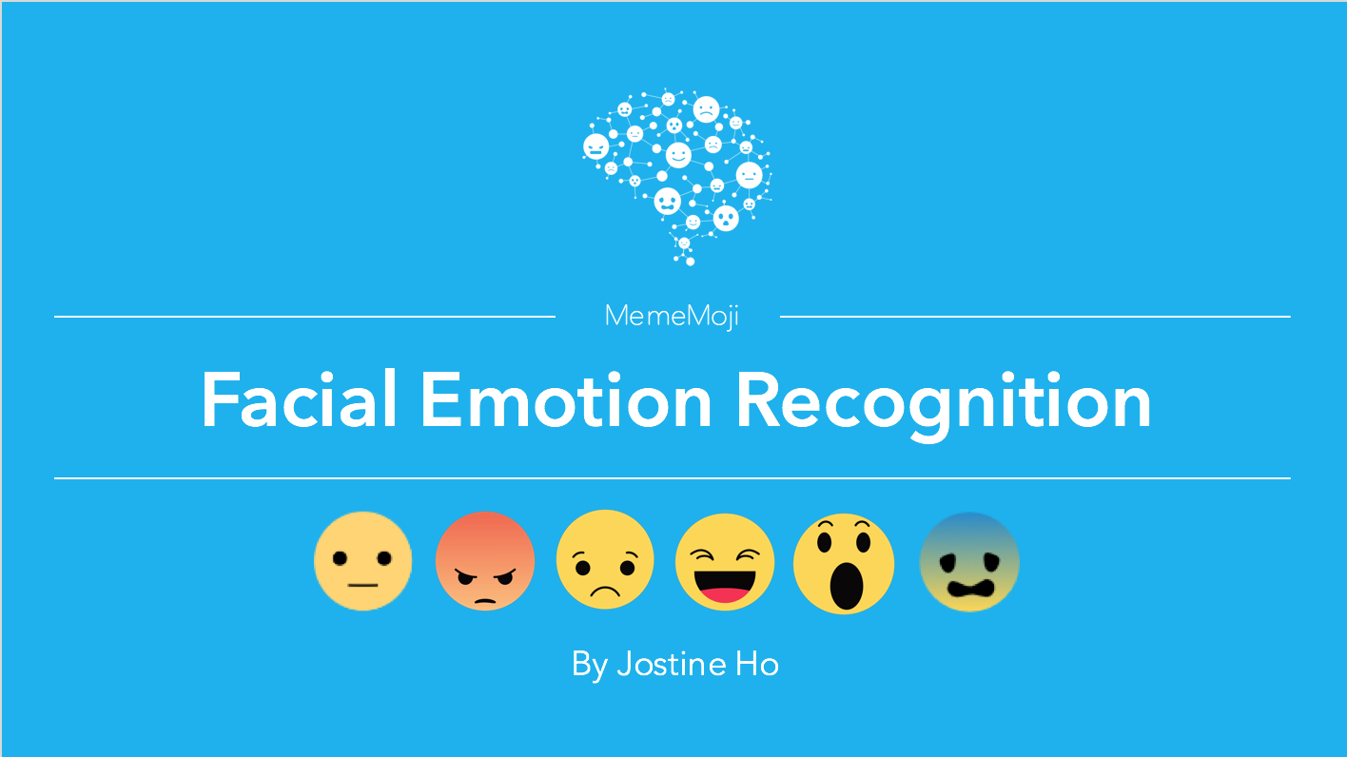
[1] Developing model & testing
No model available
Create a new model

Slide 21
[2] Developing model & testing
How we got emotional value (probability) of a face
: Implementing ‘Residual Network’
[Data set] Emotion Detection From Facial Expressions from Kaggle

Slide 22
[2] Developing model & testing
Facial expression model : Residual network
Face detection model : cv2.CascadeClassifier
Learning Environment : GTX 1070 4GB, I7-6700
Learning term : 3 days
Expression labels : ["Fear", "Happy", "Sad", "Surprise", "Neutral“]
Parameters reference https://github.com/opencv/opencv/blob/master/data/haarcascades/haarcascade_frontalface_default.xml

Slide 23
12th week’s progress
3. UI reconstruction & Mailing : Jinwoo

Slide 24
[3] UI reconstruction & Mailing
Menu structure (previous)
upload
dashboard
uploading
home
archive
payment
Notes:
upload 밑에 archive가 있는게 옳지 않다.

Slide 25
[3] UI reconstruction & Mailing
Menu structure (new)
upload
dashboard
uploading
home
archive
mypage
payment
Notes:
홈 화면에 mypage 버튼을 추가하여 archive와 payment를 한번에 관리하기로 함. -> 앱을 새로 만드느라 url 밑 하이퍼링크 수정
지금까지 하드코딩 해놓았던 html들을 template 의 기능을 최대한 활용하여 일관성있게 수정.

Slide 26

[3] UI reconstruction & Mailing
Mailing Service
Algorithm
DB update
Home
Gmail
hyperlink
Send Mail
Check

Slide 27
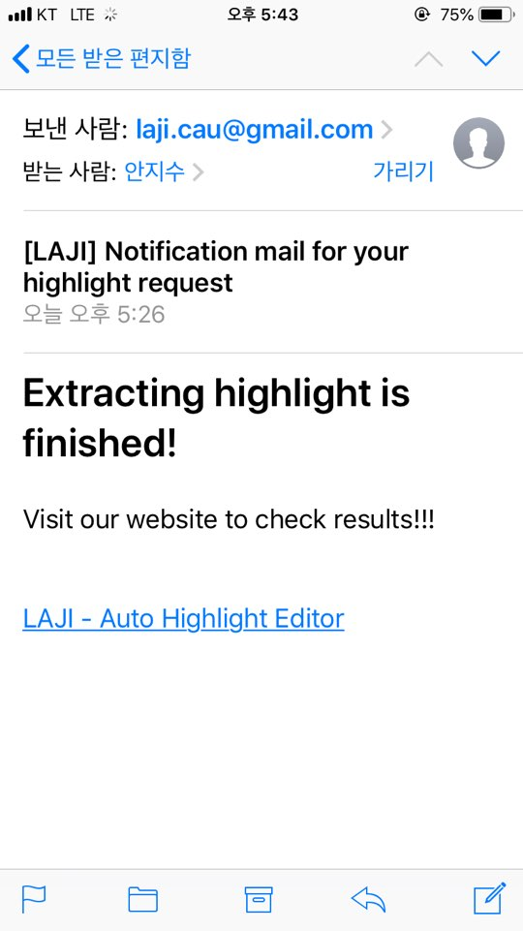
[3] UI reconstruction & Mailing

Slide 28
Development plans
Week | Plan
2nd | Idea & Proposal
3rd | Idea & Proposal
4th | Server construction (Configuration setup : Nginx, domain(bind9), https), Test videos (Twitch/Game/Eng)
5th | Login (SNS), Database
6th | Video upload & download, Twitch chat API analyze
7th | Frame resizing, Web UI, Designing highlight algorithm
8th | Demo

Slide 29
Development plans
9th | Highlight video analyze algorithm development and test
10th | Highlight video analyze algorithm development and test
11st | Highlight video analyze algorithm development and test
12nd | Toss (payment), Notification mail, algorithm development, Server test
13rd | Preparing for Final demo , Queueing for threads
14th | Final demo
15th | Final report

Slide 30
Development plans
Jisu An,
Hyunjae Lee,
Jinwoo Jeon,

Slide 31
Thank you!

